Slide 1
Relating Vision PLUS to Business

Slide 2
Major VisionPLUS Subsystems
Application Processing (CDM)
Security sub system
SSC
Merchant Processing (MBS)
Authorisations (FAS)
Credit
Management
System
Letters System (LTS)
Transaction Management (TRAMS)
Collections Tracking & Analysis (CTA)
Interchange Tracking System (ITS)
Customer Service (ASM)
Notes:
VisionPLUS handles retail, bankcard and consumer loans in one seamlessly integrated suite of systems. It combines the functionality of CardPac, the world’s most installed bankcard system, and VISION21, the leading private label credit card system.
VisionPLUS is the perfect tool for total management of all aspects of retail and bankcard processing.

Slide 3
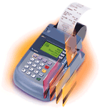

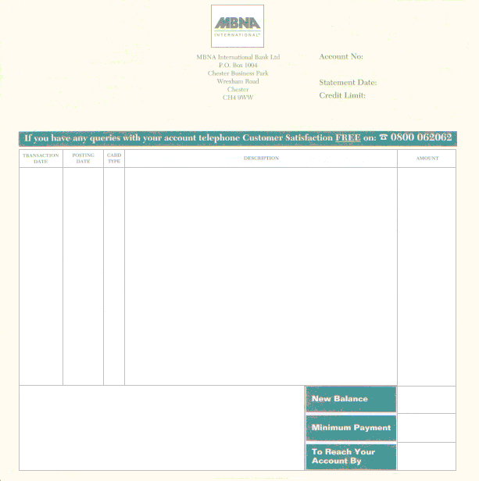
VisionPLUS – Cards Issuing Perspective
authorisation Network
Authorisations Module
(FAS)
Dispute & Intechange (ITS)
Settlement Network
Application
Processing
(CDM)
Account Receivable
(CMS)
Transaction Management (TRAMS)
Payments (Cash / Direct Debits)
Letters Module (LTS)
Collections Module (CTA)
Customer Service (ASM)

Slide 4

VisionPLUS – Merchant Acquiring Perspective
Authorisations Module
(FAS)
POS Interface / Voice Authorisation
Authorisation Network
Sales Draft capture
Merchant System (MBS)
Interchange Tracking (ITS)
Transaction Management (TRAMS)
Settlement Network

